Slide 1
PROJECT:
Tricoflex Sustainable range

Slide 2
Tricoflex :
Expertise and CSR Commitment
A French company established in the 1950s: a member of the EXEL Industries group
Quality products: over 65 years of expertise in the design and manufacture of flexible thermoplastic hoses
Values: Customer satisfaction, eco-responsibility, technical excellence, innovation
An international presence and an extensive distribution network
A wide range of markets: over 1,000 references for agriculture, food processing, industry, construction and fire-fighting
A responsible partner :
- Internal regeneration unit
- Sustainable products
- Ambition to reduce our carbon footprint (-30%)

Slide 3
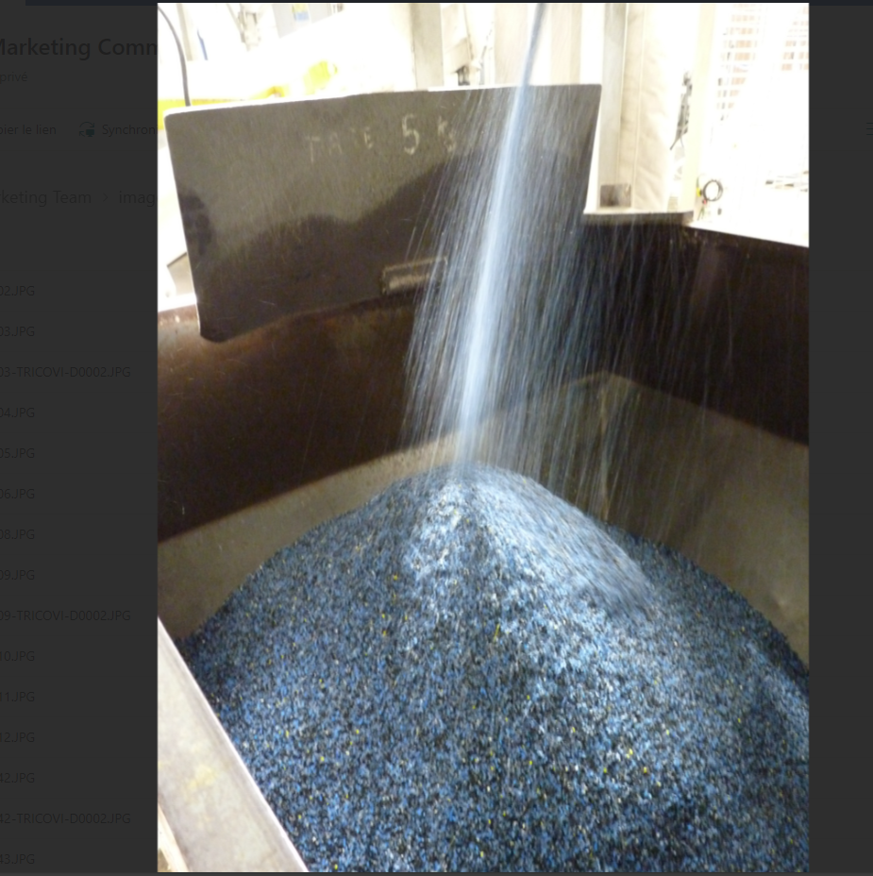
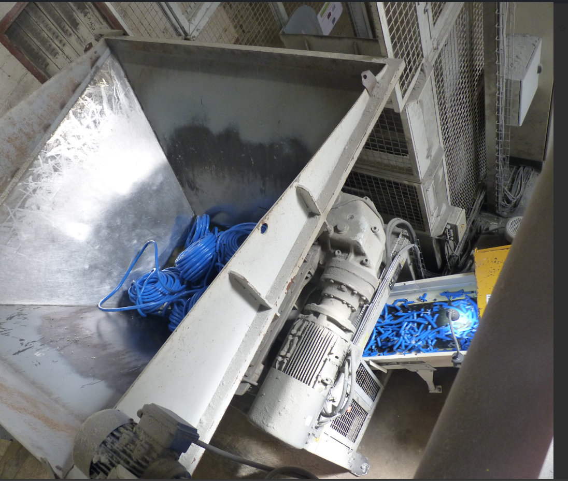

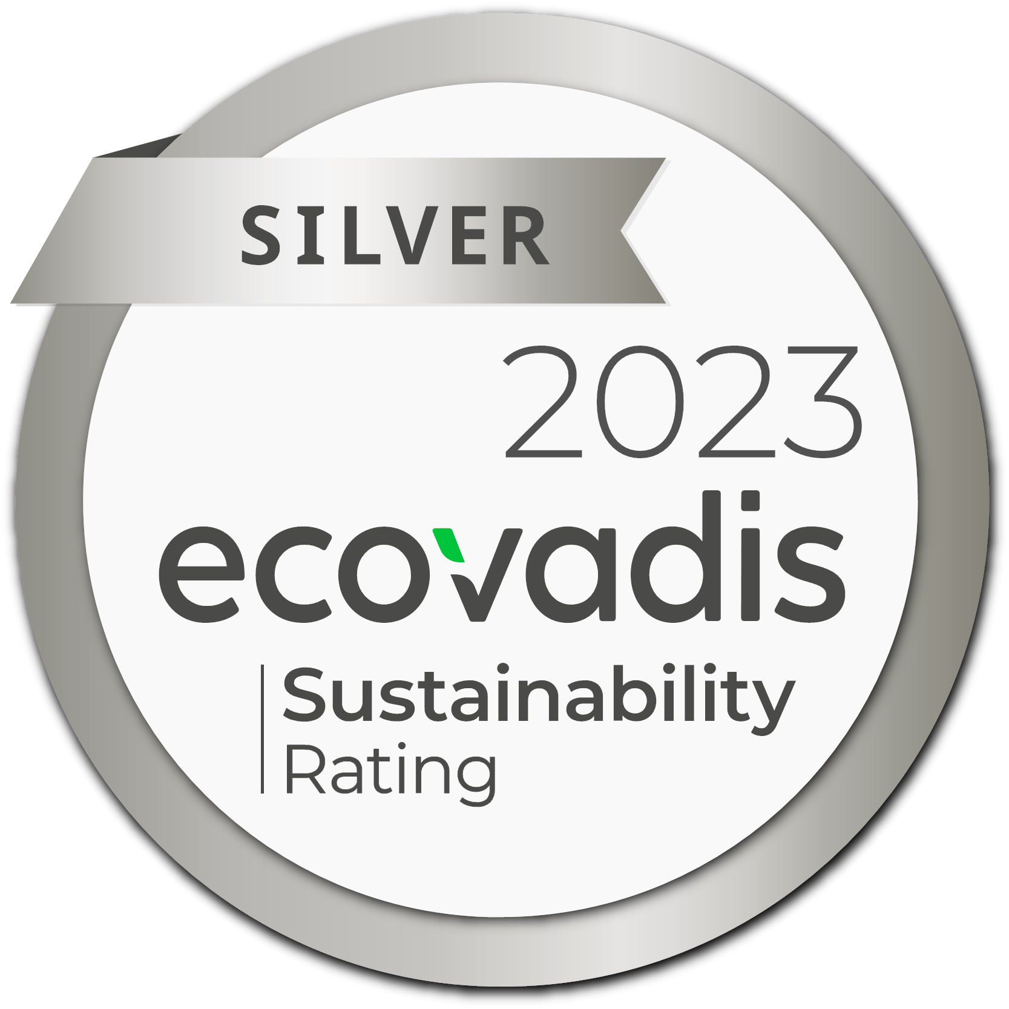
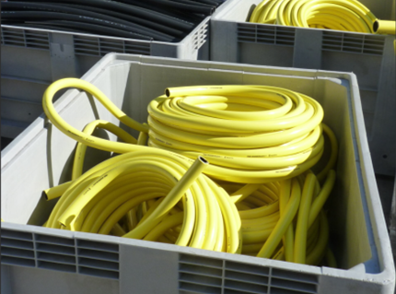
For more than 35 years, Tricoflex has been an environmentally responsible company.
It sorts, recycles and repurposes its waste.
Tricoflex strives to lower its greenhouse gas emissions in response to climate change challenges.
Our goal: Develop a new range of hoses made from a minimum of 90% recycled plastic materials.

Slide 4
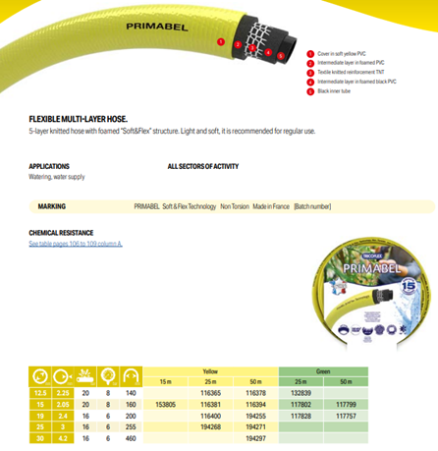
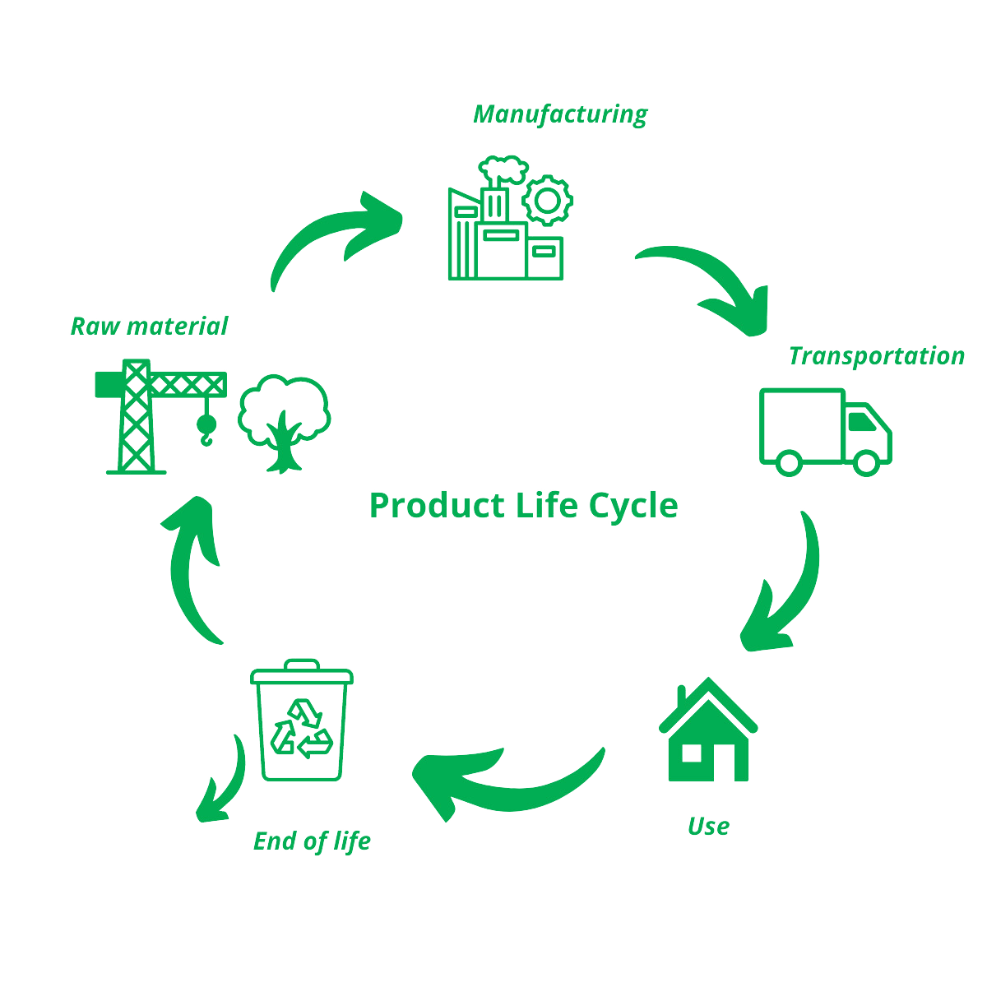
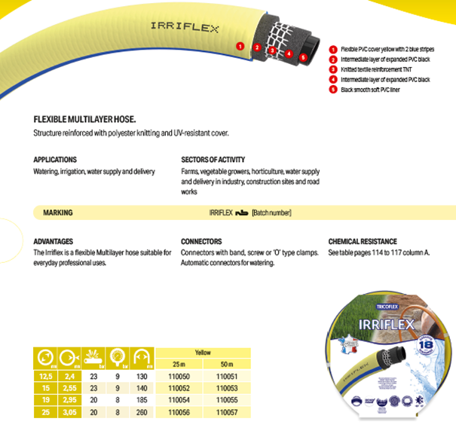
Currently, some ranges of our hoses are manufactured using 70% recycled materials.
Our results
% recycled PVC
% virgin PVC
% recycled PVC YTD

Slide 5
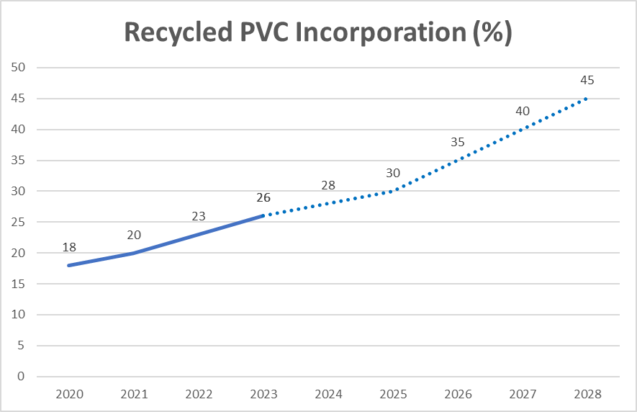
We are constantly improving the quality of our recycled plastics to meet our goal.
Our Goals
Create sustainable and high-quality products from the start (eco conception).
Introduce a new water hose made of a minimum of 90% recycled plastic materials.
Go further in the recovery of external production scraps (post-industrial and later, of post-consumer scraps).
Keep using more recycled plastics and providing more environmentally friendly products.
We aim to maintain our position as a key player in sustainable development and as an essential part of the circular economy.

Slide 6
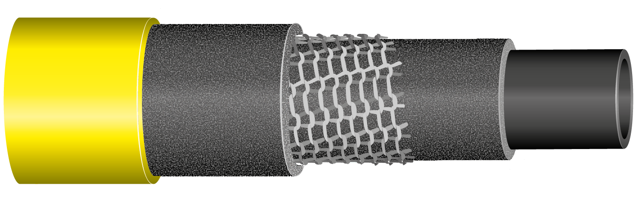

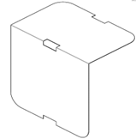
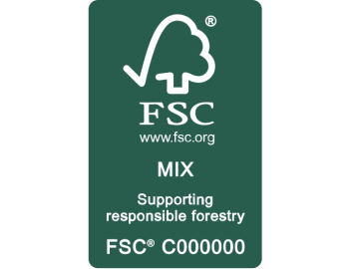
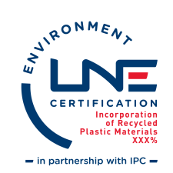
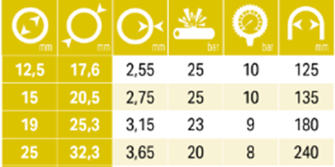
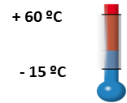
Introducing Tricoflex Sustainable range
High durability and superior flexibility due to knitted reinforcement
Tricoflex Non-Torsion Technology (TNT) employed to prevent any twisting under water
Eco-friendly packaging minimised to just the essentials
  No separate wrapping for each coil
  Lightweight, condensed FSC cardboard tag
Scheduled release in the 2025 season
> 90% plastic recycled material

